Slide 2

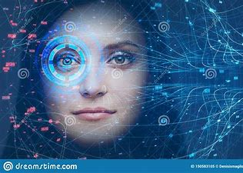
ATTENDANCE USING FACIAL
RECOGNITION
By:
Rohit raj & Abhishek kumar

Slide 3
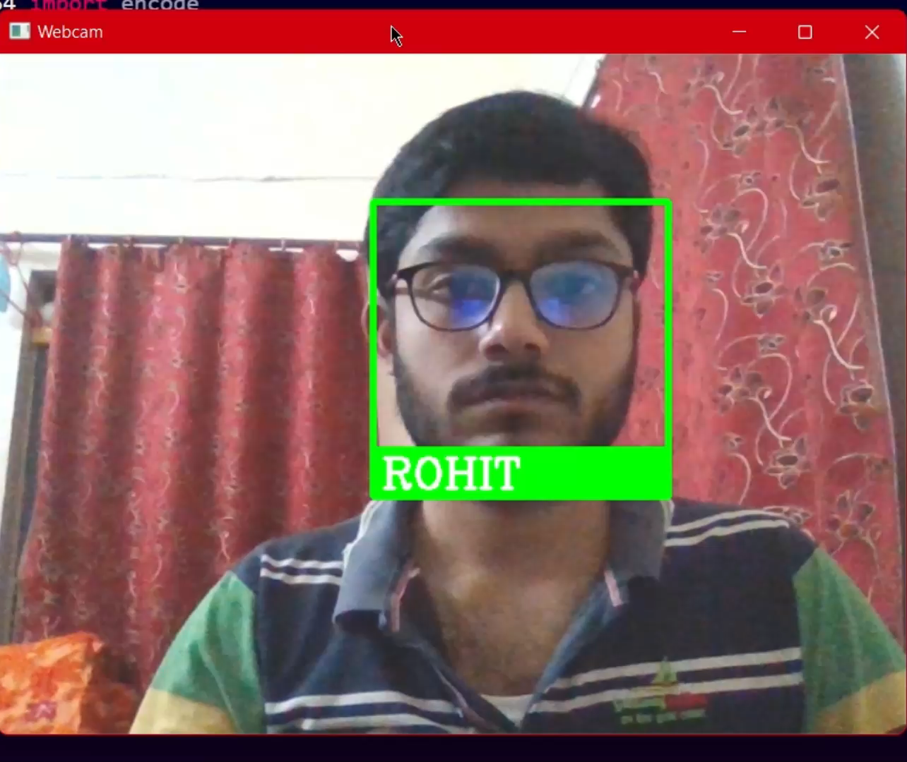
RECAP
What is Face Recognition?
How Face Recognition Technology works?
Uses of Face Recognition Technology
Attendance Project using Facial Recognition

Slide 4


Tools and packages used
Python
PyQT GUI builder

Slide 5
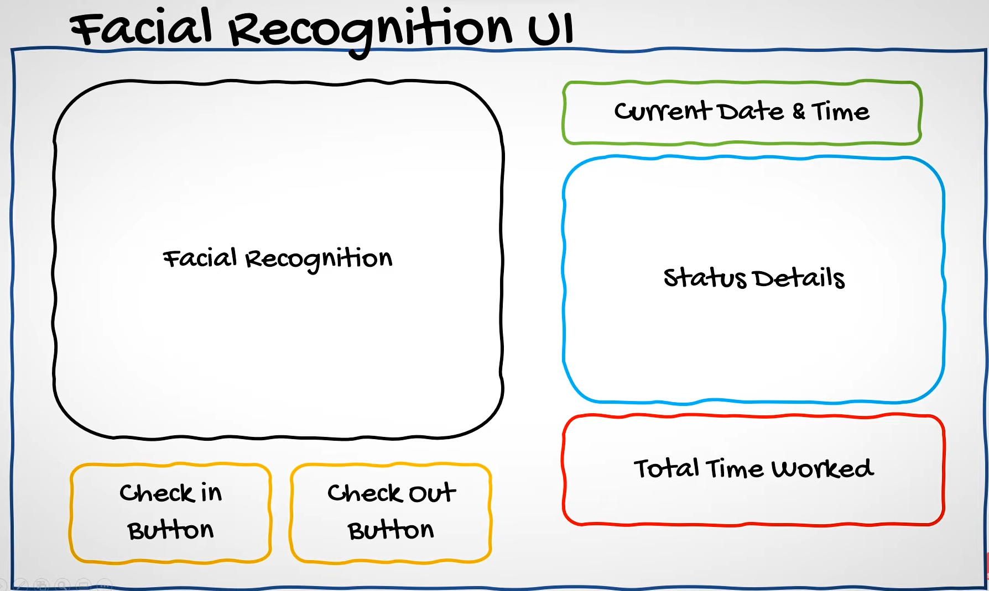
Functionality of facial recognition app

Slide 6
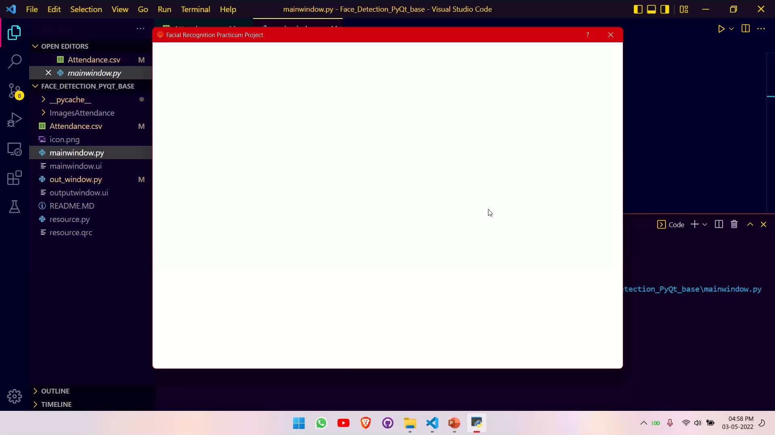

Slide 7
References
Machine Learning is Fun! Part 4: Modern Face Recognition with Deep Learning | by Adam Geitgey | Medium – Jul 2016
https://www.youtube.com/watch?v=cCeUdTXZJHs&t=137s – May 2020
https://www.youtube.com/watch?v=sz25xxF_AVE&t=362s – Jun 2020
https://www.youtube.com/watch?v=oP3MQyO-wwc – Oct 2020

Slide 8


THANK YOU
MEET THE TEAM
Rohit Raj
Abhishek Kumar

